Slide 1
Xioliuqiu mesophotic

Slide 2
2022 – Ajibye- 30m

Slide 3
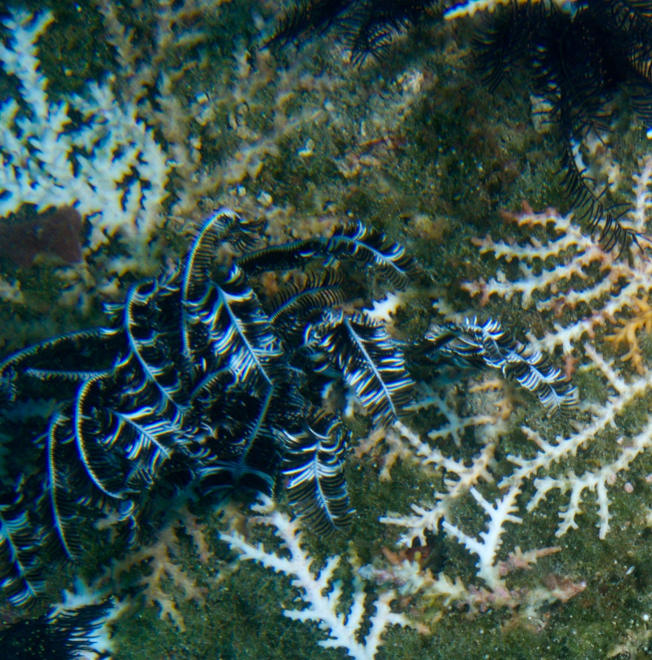
T1-10 1
Acropora tenella?

Slide 4
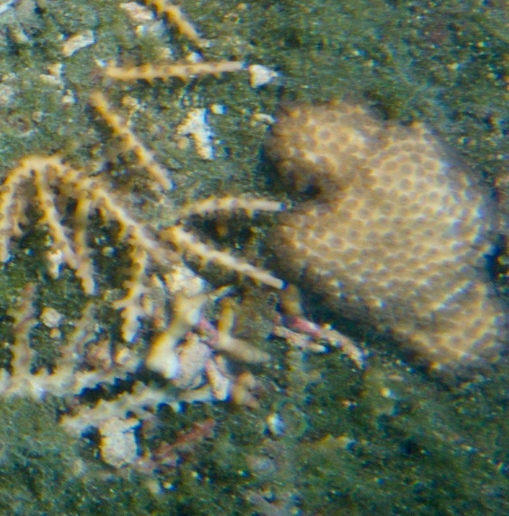
T1-6
Cyphastrea sp.

Slide 5
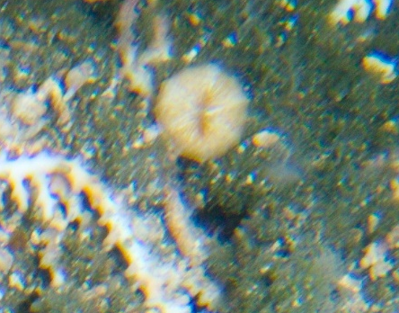
T1-13
Caulastraea sp

Slide 6
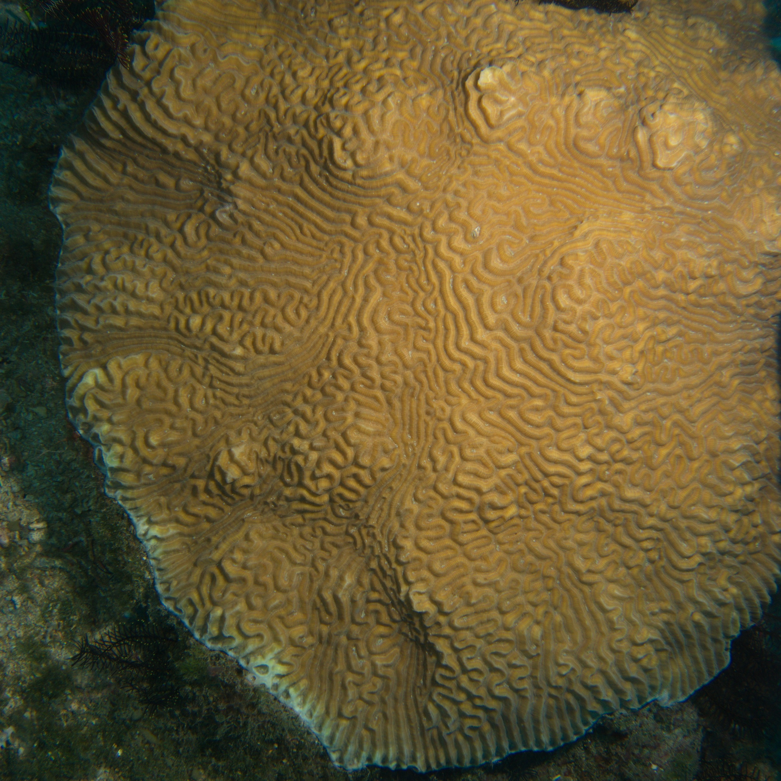
T2-4
T2 - 21
Lobophyllia sp.

Slide 7
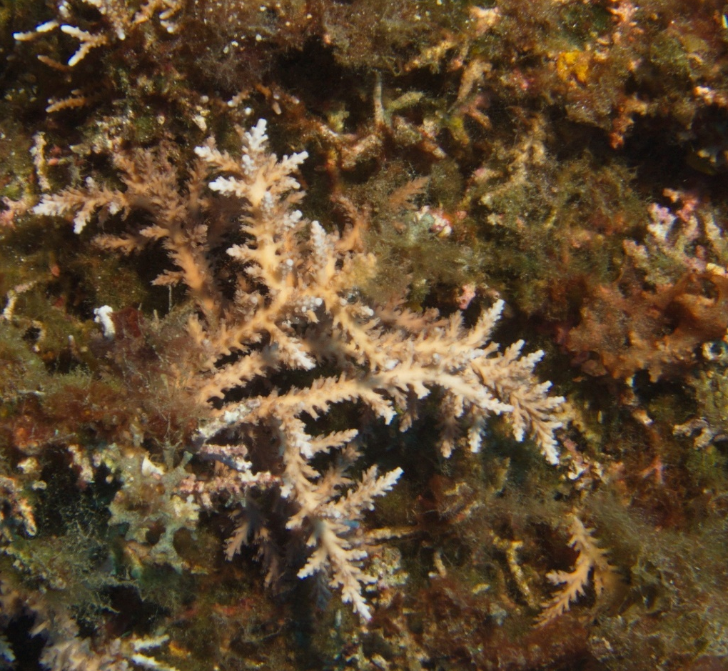
T3-12

